Slide 1
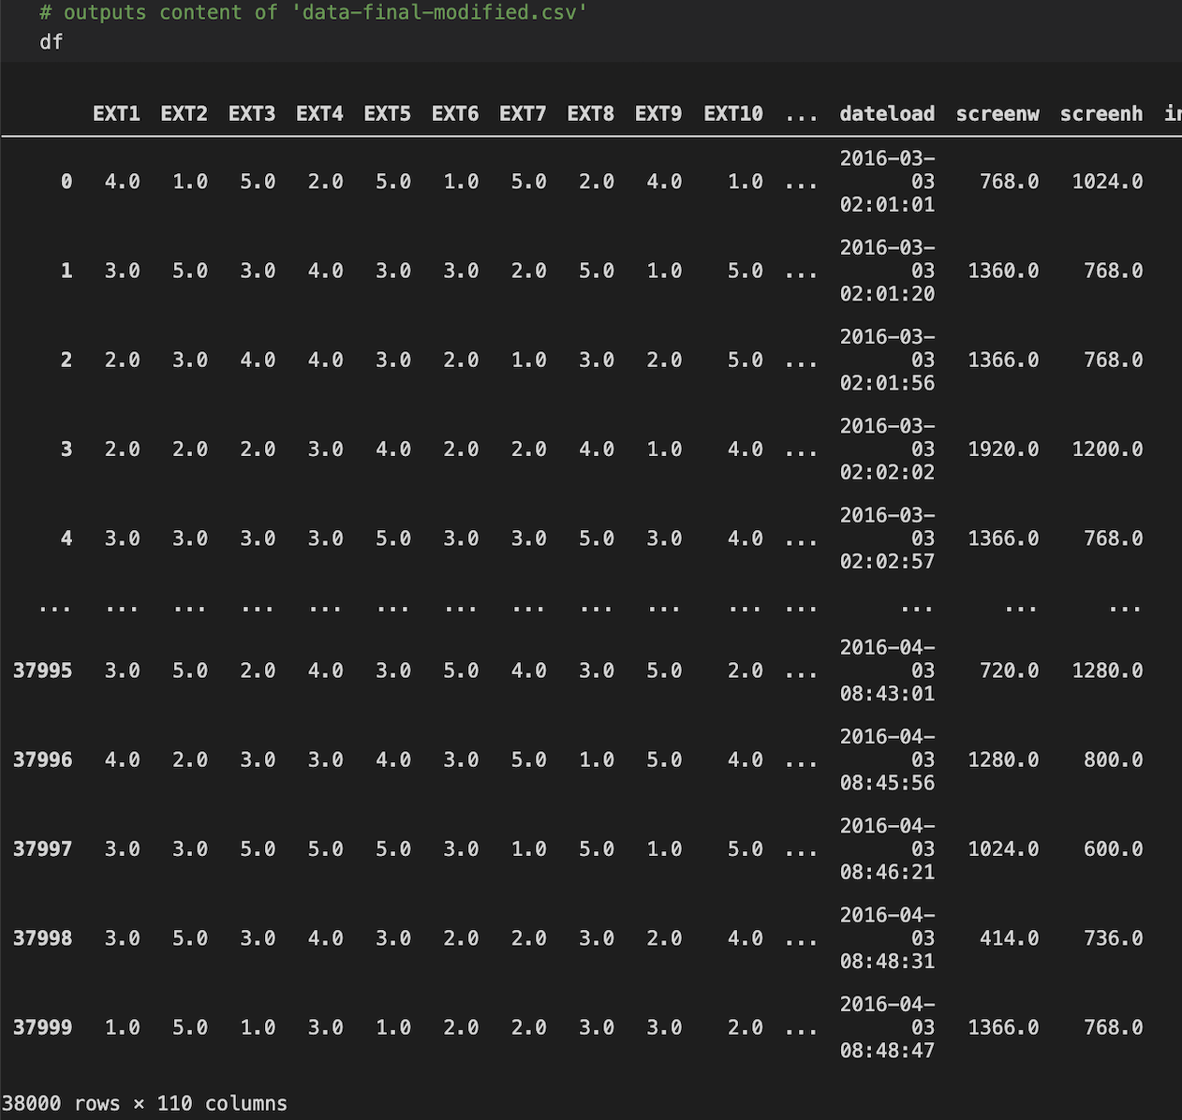
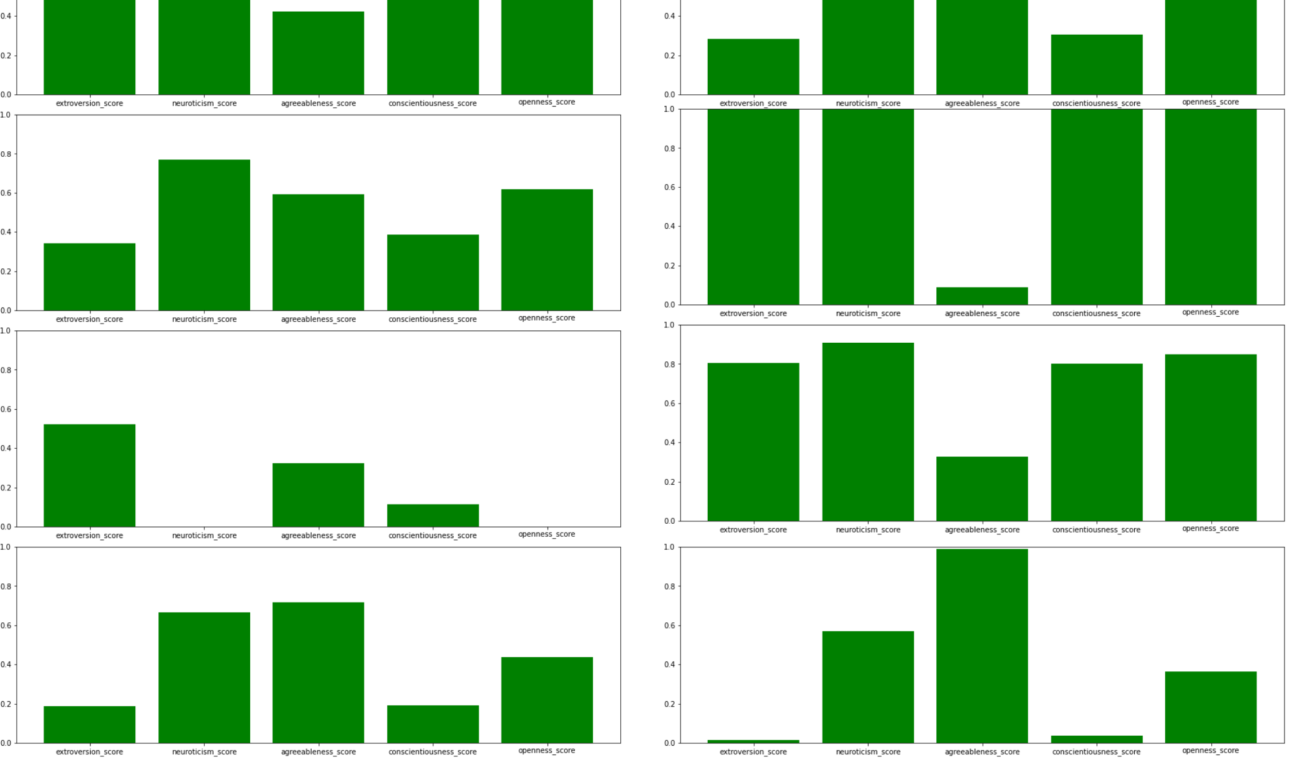
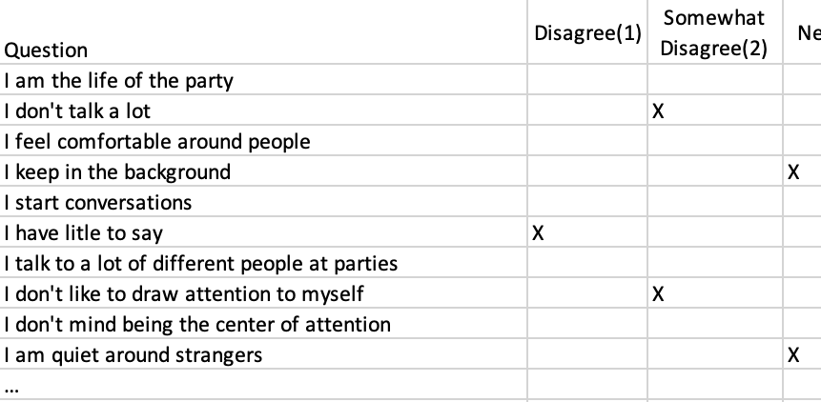
Build a Personality System Takes 38,000 responses to a 50-question test based on the Big Five Personality Test and groups the results into 10 personality types using K-Means clustering. Displays results. Shota Yasuda

